Slide 1
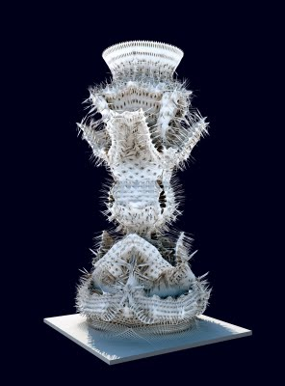

FIT1045 Introduction to Algorithms and Programming Lecture 1 Introduction to Algorithms
Images at http://bloggertowordpresstestblog.blogspot.com.au/2009/11/michael-hansmeyer-solids-at-smallspace.html:
COMMONWEALTH OF AUSTRALIA
Copyright Regulations 1969
WARNING
This material has been reproduced and communicated to you by or on behalf of Monash University pursuant to Part VB of the Copyright Act 1968 (the Act).The material in this communication may be subject to copyright under the Act.Any further reproduction or communication of this material by you may be the subject of copyright protection under the Act.
Do not remove this notice.

Slide 2
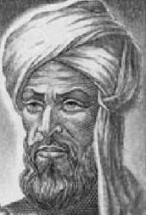
What is an Algorithm?
Image at: vindelz.wordpress.com/2009/11/algorismi1.jpg
al-Khwarizmi
(c. 750 – 850)

Slide 3
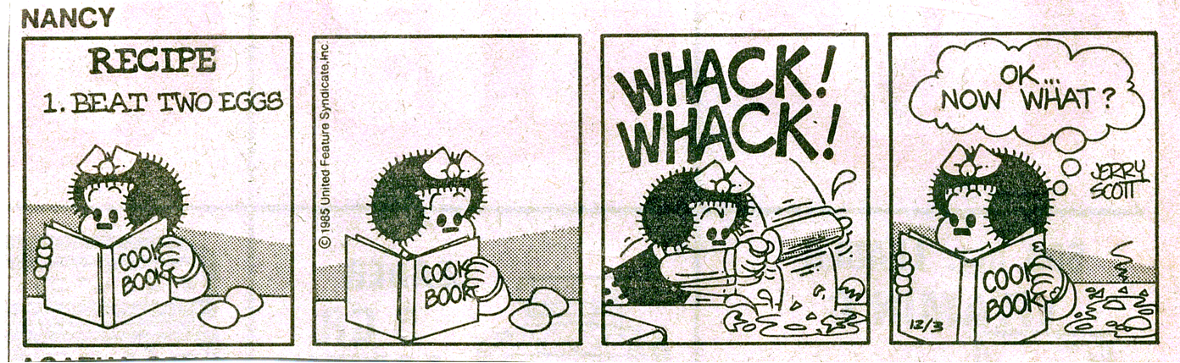
Like a recipe
This image is copyright protected. The copyright owner reserves all rights.

Slide 4
A recipe (Mousseline au chocolat)
Melt chocolate and 2 tablespoons water in double boiler. When melted, stir in powdered sugar; add butter bit by bit. Set aside. Beat egg yolks until thick and lemon-colored, about 5 minutes. Gently fold in chocolate. Reheat slightly to melt chocolate, if necessary. Stir in rum and vanilla. Beat egg whites until foamy. Beat in 2 tablespoons sugar; beat until stiff peaks form. Gently fold whites into chocolate-yolk mixture. Pour into individual serving dishes. Chill at least 4 hours. Serve with whipped cream, if desired. Makes 6 to 8 servings.
Sinclair and Malinowski, French Cooking, Weathvane Books, 1978

Slide 5
Definition
A finite sequence of steps for solving a problem with the following properties:
Finiteness
Must always terminate after a finite number of steps.
Definiteness
Each step must be precisely and unambiguously specified.
Input
Zero or more.
Output
One or more.
Effectiveness
Each step is sufficiently basic that they can be done exactly and in a finite length of time.

Slide 6
An Algorithm
Fold paper in half.
Unfold and then fold the corners into the center line.
Fold the top edges to the center.
Fold the paper in half.
Fold the sides down to meet the bottom edge of the paper.

Slide 7
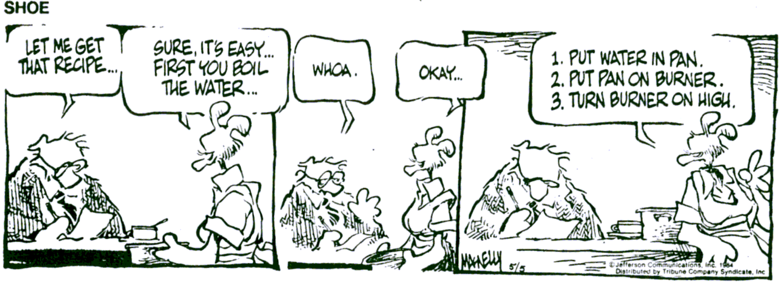
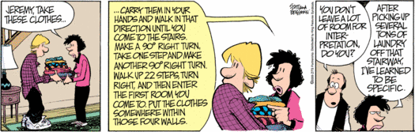
Level of Detail
These images are copyright protected. The copyright owner reserves all rights.

Slide 8
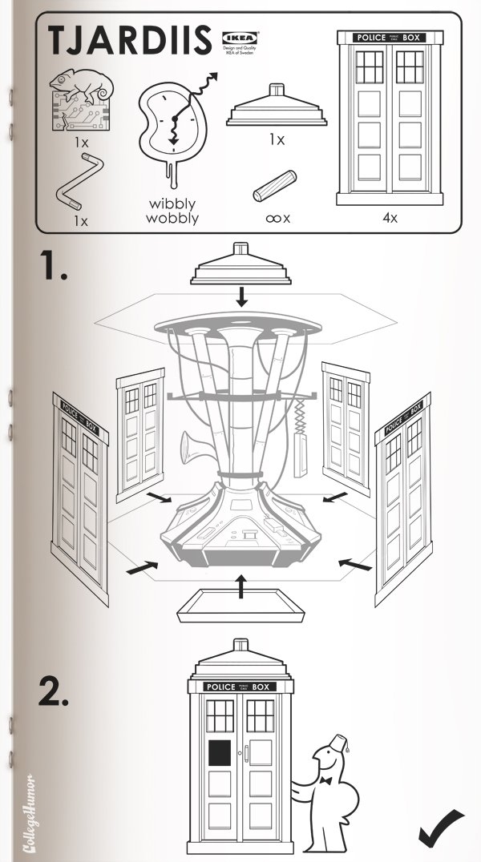
Consider
Recipes
Operating Systems
Installation guides
Programs
http://www.collegehumor.com/article/6500868/sci-fi-ikea-manuals

Slide 9
Objectives of the unit
To learn how to:
Develop algorithms
Communicate algorithms
Reason about algorithms
Understand the limitations of algorithms
Implement algorithms in Python
Develop strategies to find algorithms.

Slide 10
Lecturers
Dr Aamir Cheema
Room 113, 25 Exhibition Walk, Clayton
Tel: 9905 9662
Email: Aamir.Cheema@monash.edu
Consultation: Wednesday 2pm – 3pm
Dr Kerri Morgan
Room 119, 25 Exhibition Walk, Clayton
Tel: 9905 9559
Email: Kerri.Morgan@monash.edu
Consultation: Monday 1pm – 2pm

Slide 11
Contact Hours
Lectures (2hrs per week)
Monday 12 – 1pm,
Wednesday 12 – 1pm,
Online @ http://www.mulo.monash.edu.au/
Tutorials (2hrs per week)
Workshops(2hrs per week)
Moodle feedback activity

Slide 12
Syllabus
Week | Monday Lecture | Wednesday Lecture | Assessment
1 | Introduction to Algorithms | Introduction to Python
2 | Selection | Loops and repetition
3 | Introduction to Data Structures | Finding algorithms
4 | Invariance | Greedy Approach
5 | Brute Force | Exhaustive Search
6 | Decomposition and modules | Mid semester Test (15%)
7 | Understanding Python; Functions in Python | Divide and Conquer
8 | Recursion | Guest Lecturer
9 | Recursive sorting | Backtracking | Assignment Due (15%)
10 | Implementing Backtracking | Transform and Conquer
11 | Introduction to Complexity | Complexity for Tree Algorithms
12 | Intractable Problems | Unsolvable Problems
Notes:
Give them a brief overview of the course. Describe why puzzles are used throughout the course to explain ideas, i.e., puzzles do not need a lot of background to understand the problem and many of the puzzles are classic problems in computer science. Explain why we do not get them to program in this course, i.e., because we want them to understand the ideas without getting bogged down in the details of the implementation. Also if they understand the ideas they can implement them in whatever language they are using.

Slide 13
Assessment
Weekly Quiz on Moodle (10%)
Weeks 2--11
Assignment (15%)
Due Week 9
Mid Semester Test (15%)
Week 6 during Lecture.
Exam (60%) (3 hours)
During Exam period

Slide 14
Recommended Reading
Levitin, A., (2012) Introduction to the Design and Analysis of Algorithms (3rd Edition) Pearson
Perkovic, L. (2012) Introduction to Computing using Python: An Application Development Focus. John Wiley & Sons, Inc.

Slide 15
Submission of Assignments
Submission details will be specified on each assignment/laboratory sheet
You will submit your assignments to Moodle.
Whenever you submit an assignment you must complete an assignment submission form.
Late submission will have 5% off the total assignment marks per day (including weekends).
Assignments submitted 7 days after the due date will normally not be accepted.
Extensions
Not normally given.
Genuine and compelling reasons only.
Supporting documentations are needed BEFORE any consideration would be given.

Slide 16
Cheating, Collusion, Plagiarism
Cheating: Seeking to obtain an unfair advantage in an examination or in other written or practical work required to be submitted or completed for assessment.
Collusion: Unauthorised collaboration on assessable work with another person or persons.
Plagiarism: To take and use another person’s ideas and or manner of expressing them and to pass them off as one’s own by failing to give appropriate acknowledgement. This includes material from any source, staff, students or the Internet – published and un-published works.
http://infotech.monash.edu.au/resources/student/assignments/policies.html

Slide 17
Hurdles
To pass this unit a student must obtain:
40% or more in the unit's examination, and
40% or more in the unit's total non-examination assessment, and
an overall unit mark of 50% or more.
If a student does not pass these hurdles then a mark of no greater than 49N will be recorded for the unit.

Slide 18
Help is Available
Lecturer
Tutors
Help Room Consultations
PASS
Moodle
Co-ordinators
Administration Officers

Slide 19


PARTICIPATE & ACHIEVE BETTER RESULTS
Peer-Assisted Study Sessions in FIT1045
Support from a successful student who has already achieved a great mark in the unit
Help with key content and concepts
Study skills for academic success at uni.
A network of friends who all want to do well
The PASS Equation
1 hour of PASS = 3 hours struggling on your own
Better Teaching, Better Learning
Office of the Vice-Provost (Learning and Teaching)

Slide 20
PARTICIPATE & ACHIEVE BETTER RESULTS
PASS GETS RESULTS
Weekly study sessions
Guaranteed study time each week to help you achieve a better mark
Students who regularly attend PASS are:
less likely to fail the unit
more likely to score a Credit, Distinction or High Distinction
Unit graph from previous version of the unit, FIT1029 from S2, 2015.
Better Teaching, Better Learning
Office of the Vice-Provost (Learning and Teaching)

Slide 21
PARTICIPATE & ACHIEVE BETTER RESULTS
SIGN UP TO PASS
Sign up for PASS via Allocate+ in Week 2
Select a FIT1045 PASS session that fits your schedule
No spots left in the session you can attend? Click on the Waiting List hyperlink on the PASS website (www.monash.edu/pass-program) and complete the form
PASS study sessions begin in Week 3. See you there!
Better Teaching, Better Learning
Office of the Vice-Provost (Learning and Teaching)

Slide 22

Sign up for PASS on Allocate+ in Week 2
Select a FIT1045 PASS session that fits your schedule
No spots left you can attend?
Complete the Waiting List form on the PASS website
http://www.monash.edu/students/pass-program/
PASS study sessions begin in Week 3. See you there!

Slide 23
Do you have any form of condition (medical, disability other) that impacts on your ability to study?
Disability Support Services provides a range of services for registered students including:
Notetakers and Auslan interpreters
Readings in alternative formats
Adaptive equipment and software
Alternative arrangements for exams
For further information and details about how to register:
Email: disabilitysupportservices@monash.edu
Phone: 03 9905 5704
Web: monash.edu/disability

Slide 24
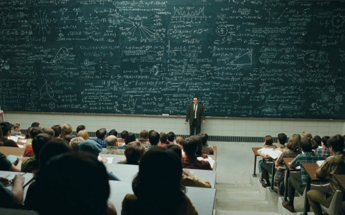
Conventional Lectures
http://www.pedagogygeek.com/category/uncategorized/

Slide 25

Some Issues
http://gregteselle.com
Difficult for students to remain attentive.
Not enough opportunity to critically think through the concepts.
Reinforces the feeling that the most important part of learning is to memorize material.
Difficult for lecturers to gauge students’ understanding.

Slide 26

Peer Instruction

Slide 27
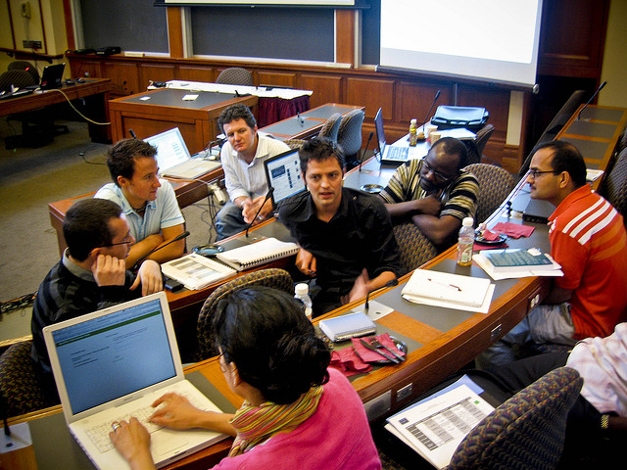
The Approach
Lectures are interspersed with questions.
You are given some time to think about the question
You then give your responses.
We look the responses.
You then spend some time discussing your answers with the students around you.
You respond again.
We then look at the responses and discuss them as a class.

Slide 28
Using MARS
Visit http://mars.mu on your internet enabled device
Log in using your Authcate details (not required if you’re already logged in to Monash)
Touch the + symbol
Enter the code for your unit: ZIETFF
Answer questions when they pop up.

Slide 29
Multiple choice questions
1+1 = ?
2
10
11
Not sure
Hint: There are 10 types of people in this world. Those who understand binary and those who don’t.

Slide 30
Text-based poll
Write the name of your favorite fruit.

Slide 31
Before Next Lecture
Log onto the FIT1045 Moodle site
Watch the following videos:
What is a tree?
What is a graph?
Set up MARS.
Attempt the following problem …

Slide 32
Age of the Kids
Two men meet on the street
A: All three of my sons celebrate their birthday today. Can you tell me how old each one is?
B: Yes, but you have to tell me something about them…
A: The product of their ages is 36.
B: I need more info…
A: The sum of their ages is equal to the number of windows in the building next to us…
B: I need more info…
A: My oldest son has blue eyes.
B: That is sufficient!
Notes:
32

